Slide 1
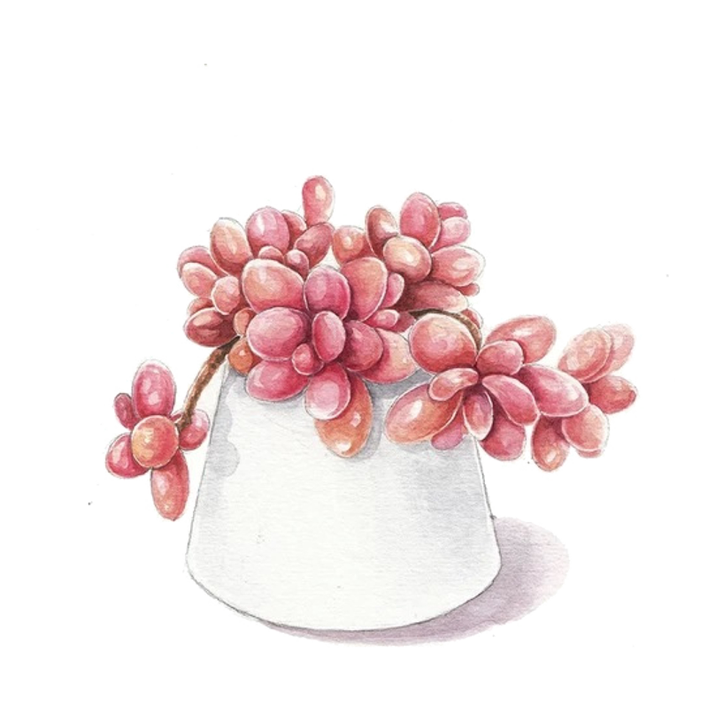
Digital portfolio
Student Name:M.Vidhya sri
Register no And NMID:40648BC39EA43C9B87E4E7468837D801
Department:BCA
College: Kanchi Sri Mahalakshmi Arts and science college for women

Slide 2

Project Title
Digital portfolio

Slide 3
Agenda
1.Problem statement
2.Project Overview
3.End users
4.Tools and Technologies
5.Portfolio design and layout
6.Features and Functionality
7.Results and Screenshots
8.conclusion
9.Github link

Slide 4
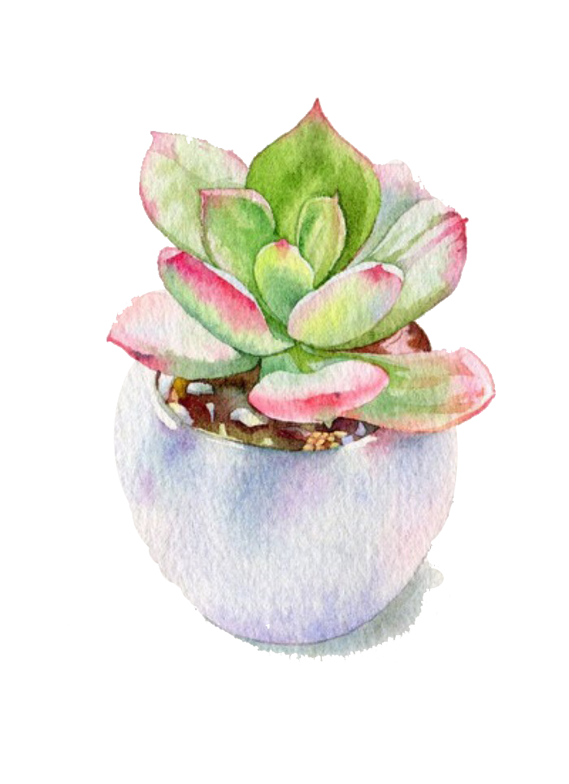
Problem Statement
1.Need for an iterative portfolio to present talents.
2.Limited awareness of industry - required skills.
3.Many students lack of a structure platform to showcase skills.

Slide 5
Project Overview
* A digital portfolio devloped under Nanmudalvan.
* Easy-to-use customisable and career-oriented.
* Helps students highlight skills, project,and achievements.

Slide 6
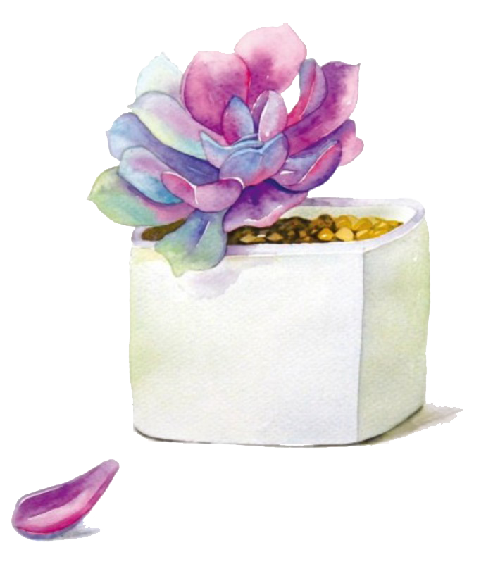
Who are the job users?
1.College students
2.Job seekers/fresh graduates.
3.Training &skill development students.

Slide 7
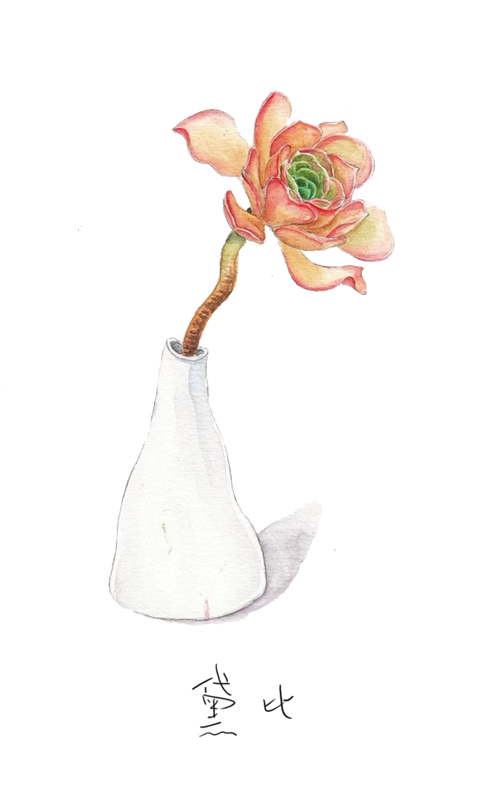
Tools And Techniques
1.Programming languages: css,Javascript, HTML
2.Tools: codepen,Gitup.
3.Techniques:Responsive web design.

Slide 8
Portfolio Design and Layout
1.Home page: personal intro
2.Skill page:Technical&soft skill
3.Project page: Academic projects

Slide 9

Features and Functionality
1.Fully customisable by students.
2.Provides real-time updates of profile.
3.Cross -platform compatibility (PC, tablet, mobile)

Slide 10
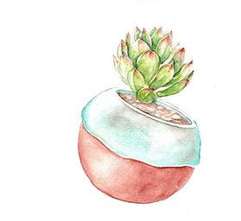
Results & screenshots.
1.Working prototype successfully implemented.
2.Portfolio shows skills projects, achievements clearly.
3.Screen shots: Landing
4.Page/About/skills/projects/contact .

Slide 11
Conclusion.
1.Developed a career - oriented digital portfolio.
2.Provides long-term use beyond academic.
3.Feature scope- Add AI based resume bulder.

Slide 12
Thank you...

